Slide 1
More UML
Activity, Sequence, Communication, Timing, Component, and State Diagrams

Slide 2
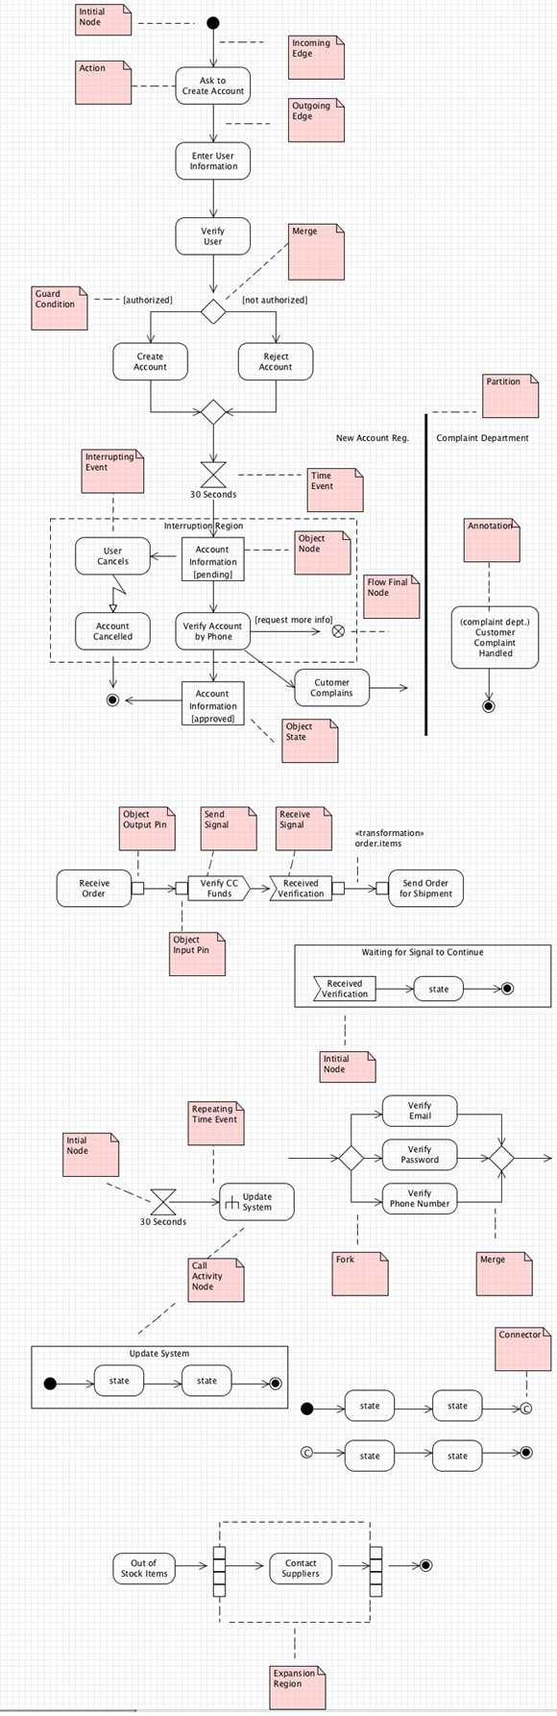
Activity Diagrams
Shows what actions occur to achieve a goal.
Similar to flowcharts

Slide 3
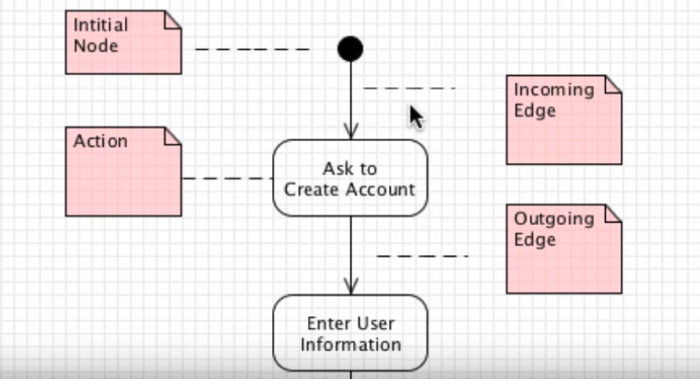
Start of Activity Flow

Slide 4
Activity Diagrams
Have actions.
Have incoming edges and outgoing edges.

Slide 5
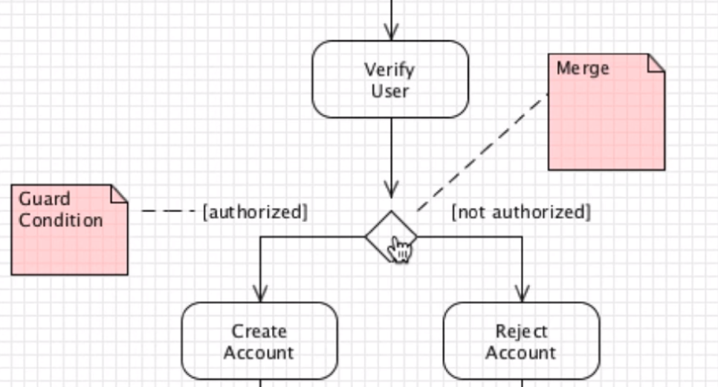
Activity Merges

Slide 6
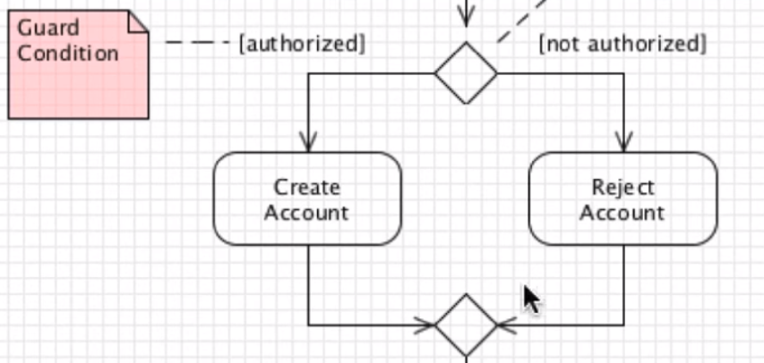
Activity Merges
Combines edges that are separated by a decision.
Have guard conditions.
Many times the separate paths recombine in a merge point.

Slide 7
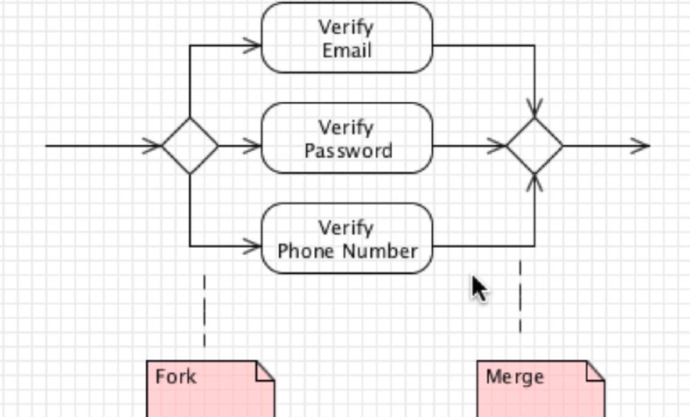
Merge Points/Multiple Actions
Consists of a fork, multiple actions, and a merge.

Slide 8
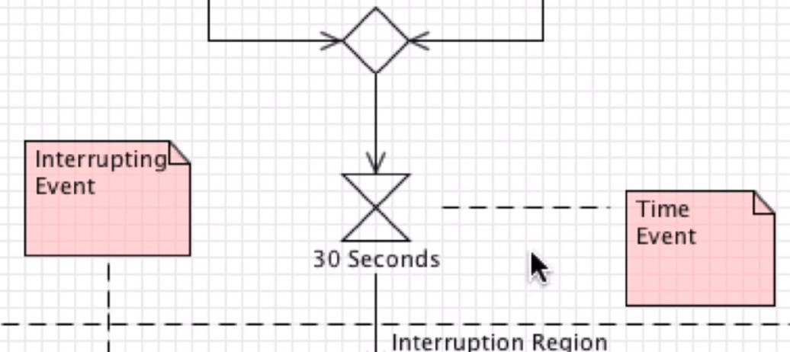
Time Event

Slide 9
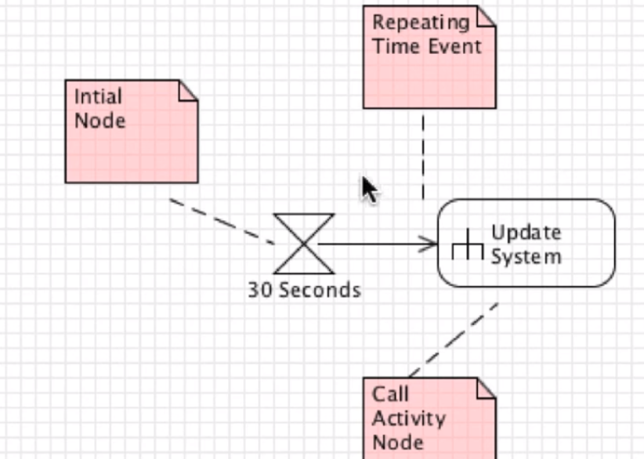
Time Events/Initial Nodes
May need repeating time events.

Slide 10
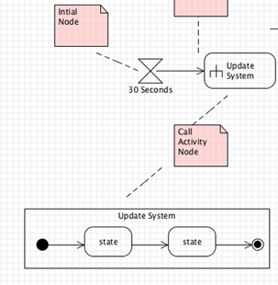
Multiple Activities Shortcut

Slide 11
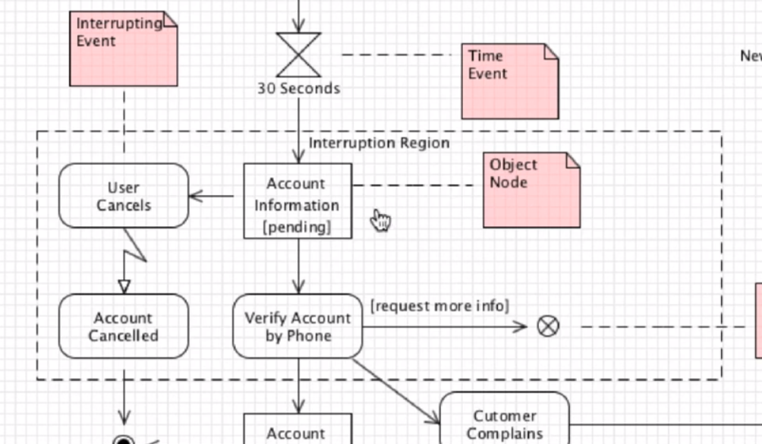
Object Nodes

Slide 12
Interruption Regions and Events
Some processes can be interrupted.
An interruption region shows the group of tasks that can be interrupted.
Can have a flow final node.

Slide 13
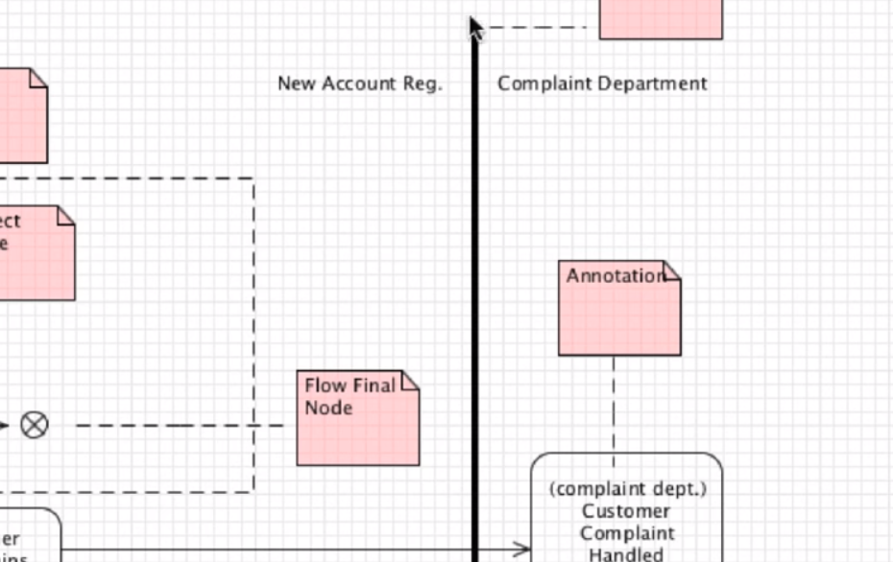
Partitions

Slide 14
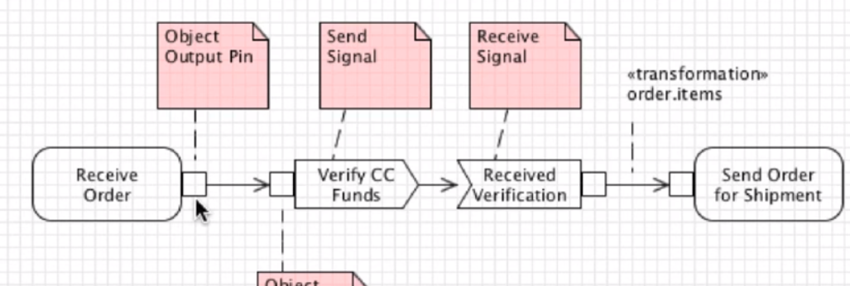
Object Outputs

